Slide 1


Bluetooth

Slide 2

The word "Bluetooth" is an anglicized version of the Scandinavian Blåtand/Blåtann, the epithet of the tenth-century king Harald I of Denmark and parts of Norway who united dissonant Danish tribes into a single kingdom.
It is a cable-replacement technology: new technology using short-range radio links, intended to replace the cable(s) connecting portable and/or fixed electronic devices
conceived initially by Ericsson in 1994, commercially come out in bulk around 2002
a standard for a small , cheap radio chip to be plugged into computers, printers, mobile phones, etc
The Bluetooth Special Interest Group (SIG) was founded by Ericsson,IBM,Intel,Nokia and Toshiba in February 1998, to develop an open specification for short-range wireless connectivity
Bluetooth
Notes:
Mobicom 2000
Aug 6, 2000
Tutorial 3: Bluetooth

Slide 3




A new global standard for data and voice
Goodbye Cables !
Bluetooth

Slide 4

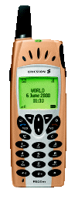
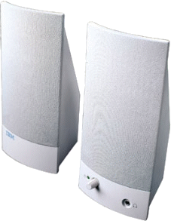


Bluetooth

Slide 5




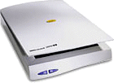
Bluetooth

Slide 6


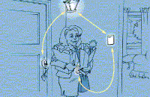
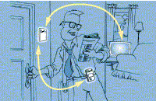
In the Office
At Home
Bluetooth

Slide 7
Bluetooth radio modules operate in the unlicensed ISM band centered at 2.45GHz. RF channels:2420+k MHZ, k=0..78.
Bluetooth devices within 10m of each other can share up to 720kbps of capacity
Projected cost for a Bluetooth chip is ~$5. Plus its low power consumption, means you could literally place one anywhere.
Can operate on both circuit and packet switching modes, providing both synchronous and asynchronous data services
It is intended to support an open-ended list of applications, including data, audio, graphics and even video.
Bluetooth
Notes:
Mobicom 2000
Aug 6, 2000
Tutorial 3: Bluetooth

Slide 8

Connection Type | Spread Spectrum (Frequency Hopping)
MAC Scheme | FH-CDMA
Spectrum | 2.4 GHz ISM
Modulation | Gaussian Frequency Shift Keying
Transmission Power | 1 mw – 100 mw
Aggregate Data Rate | 1 Mbps
Range | 30 ft
Supported Stations | 8 devices
Voice Channels | 3
Data Security- Authentication Key | 128 bit key
Data Security-Encryption Key | 8-128 bits (configurable)
Bluetooth

Slide 9
Bluetooth must be able to:
  Recognize any other Bluetooth device in radio range
  Permit easy connection of these devices
  Be aware of the device types
  Support service discovery
Examples of Bluetooth uses:
  Briefcase email: access email while the PC is still in the briefcase; when PC receives an email, you are notified thru the mobile phone. Use the mobile phone to browse the email.
  Cordless desktop: connect your desktop/laptop cordlessly to printers, scanner, keyboard, mouse, etc.
Bluetooth
Notes:
Mobicom 2000
Aug 6, 2000
Tutorial 3: Bluetooth

Slide 10
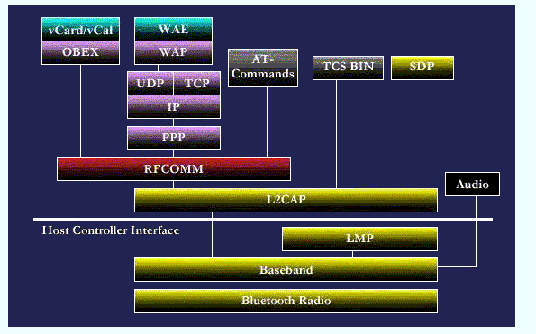
Core protocols
Telephony control protocols
Cable replacement protocols
Adopted protocols
Bluetooth
Notes:
Mobicom 2000
Aug 6, 2000
Tutorial 3: Bluetooth

Slide 11
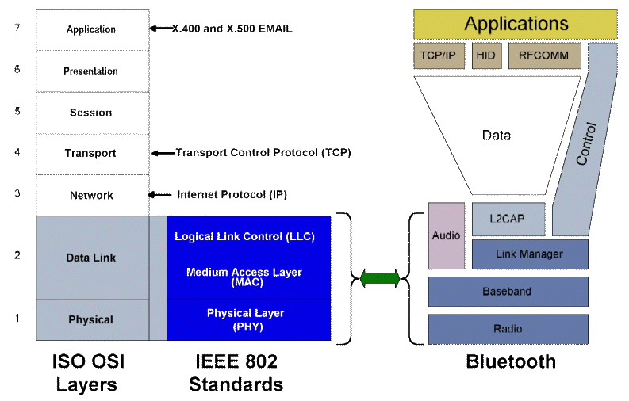
Bluetooth
Notes:
Mobicom 2000
Aug 6, 2000
Tutorial 3: Bluetooth

Slide 12
Composed of protocols to
  allow Bluetooth devices to locate each other
  create, configure and manage both physical and logical links
  that allow higher layer protocols and applications to pass data through these transport protocols
Applications
IP
SDP
RFCOMM
Control
Data
Audio
L2CAP
Link Manager
Baseband
Transport Protocol Group
RF
Bluetooth

Slide 13


Radio Frequency (RF)
    Sending and receiving modulated bit streams
Baseband
    Defines the timing, framing
    Flow control on the link.
Link Manager
    Managing the connection states.
    Enforcing Fairness among slaves.
    Power Management
Logical Link Control &Adaptation Protocol
    Handles multiplexing of higher level protocols
    Segmentation & reassembly of large packets
    Device discovery & QoS
Bluetooth

Slide 14

Additional transport protocols to
  allow existing and new applications to operate over Bluetooth.
  Packet based telephony control signaling protocol also present.
  Also includes Service Discovery Protocol (SDP)
Applications
IP
SDP
RFCOMM
Control
Data
Middleware Protocol Group
Middleware Protocol Group
Audio
L2CAP
Link Manager
Baseband
RF
Bluetooth

Slide 15

Service Discovery Protocol (SDP)
    Means for applications to discover device info, services and its characteristics.
TCP/IP
    Network Protocols for packet data communication, routing
RFCOMM
    Cable replacement protocol, emulation of serial ports over wireless network
    And several others
Bluetooth

Slide 16

Application Group
Applications
IP
SDP
RFCOMM
Consists of Bluetooth aware as well as un-aware applications.
Control
Data
Audio
L2CAP
Link Manager
Baseband
RF
Bluetooth

Slide 17

Point to Point Link
    Master - slave relationship
    Bluetooth devices can function as masters or slaves
Piconet
    It is the network formed by a Master and one or more slaves (max 7).
    Each piconet is defined by a different hopping channel to which users synchronize to.
    Hopping pattern is determined by the master.
    Each piconet has max capacity (1 Mbps).
m
s
m
s
s
s
Bluetooth

Slide 18

Master
    Device in Piconet whose clock and hopping sequence are used to synchronize all other devices (slaves) in the Piconet.
    It also carries out Paging procedure and also Connection Establishment.
Slaves
    Units within the piconet that are synchronized to the master via its clock and hopping sequence.
    After connection establishment, Slaves are assigned a temporary 3 bit member address to reduce the no. of addressing bits required
Bluetooth

Slide 19

Master
Active Slave
Parked Slave
Standby
Bluetooth

Slide 20

Synchronous Connection Oriented (SCO)
    Allocates a fixed bandwidth between a point-to-point connection involving the master and one slave.
    Point to Point Full Duplex between Master & Slave
    Established once by master & kept alive till released by Master
    Typically used for Voice connection ( to guarantee continuity )
    Master reserves slots used for SCO link on the channel to preserve time sensitive information
    SCO packets do not include a CRC and are never retransmitted.
    The master can support up to 3 simultaneous SCO links
Bluetooth

Slide 21
Asynchronous Connection Link (ACL)
    a point-to-multipoint link between the master and all slaves in the piconet.
    Packet-switch style of connection
    No bw reservation possible
    Delivery may be guaranteed thru error detection and retransmission
    Only single ACL link can exist
Bluetooth

Slide 22

STANDBY
PAGE
PAGE SCAN
INQUIRY
SCAN
INQUIRY
MASTER
RESPONSE
SLAVE
RESPONSE
INQUIRY
RESPONSE
CONNECTION
BLUETOOTH State Transition Diagram
Bluetooth
Notes:
Mobicom 2000
Aug 6, 2000
Tutorial 3: Bluetooth

Slide 23
Standby: the default state; a low power state in which only the native clock is running.
Connection: the device is connected to the piconet as a master or slave.
Bluetooth
Notes:
Mobicom 2000
Aug 6, 2000
Tutorial 3: Bluetooth

Slide 24
Inquiry:
  device has issued an inquiry to find the identity of the devices within range
  Transmission is repeated on the inquiry hop sequence of frequencies.
Inquiry scan:
  Device periodically enters this mode and listens for an inquiry
Inquiry response:
  When an inquiry message is received in the inquiry scan state, a response FHS (Frequency Hop Synchronization) packet containing the responding device’s address must be sent
Bluetooth
Notes:
Mobicom 2000
Aug 6, 2000
Tutorial 3: Bluetooth

Slide 25

Inquiry Response
Bluetooth

Slide 26
Invoked when a potential master identifies devices in range that wish to participate in a piconet
In Inquiry state, master sends an IAC (inquiry access code) over each of 32 wake-up carriers ( out of 79) in turn
Devices in the Standby state periodically enter Inquiry Scan state to search for IAC msg
When a device receives the inquiry, enters Inquiry Response state and returns an FHS packet with its device addr and timing info. Then it moves to the Page scan state to await for a page from the Master to establish the connection
If a collision occurs in Inquiry Response phase (more devices respond to an inquiry), no page will be received and the device may need to return in Inquiry Scan state
The master does not respond to FHS pkt and may remain in Inquiry state until is satisfied with all radios found
Bluetooth
Notes:
Mobicom 2000
Aug 6, 2000
Tutorial 3: Bluetooth

Slide 27
Page:
  device has issued a page message by transmitting slave’s DAC (device access code).
  Used by the master to activate and connect to a slave.
  The master uses the clock information, to determine where in the hop sequence, the slave might be listening in the page scan mode.
Page Scan:
  The page scan substate can be entered by the slave from the standby state or the connection state.
  device is listening for a page with its own DAC
Master response:
  master receives a page response from a slave. The master can enter the connection state or return to the page state to page for other slaves.
Slave response:
  a slave responds to a page from the master. If connection setup succeeds, device enters connection state, otherwise page scan state
Bluetooth
Notes:
Mobicom 2000
Aug 6, 2000
Tutorial 3: Bluetooth

Slide 28
For each device, the master uses the device’s addr to calculate a page FHS
The master pages by using an ID pkt, with a DAC of the specific slave
The slave responds by returning the same DAC ID pkt to the master in the same FHS used by the master
Master responds in the next master-to-slave slot with its own FHS pkt containing its device addr and Bluetooth clock value
Slave sends a response DAC ID pkt to confirm the receipt of the master’s FHS ( Slave Response → Connection )
The master may continue to page until it has connected all desired slaves then enters the Connection state
Bluetooth
Notes:
Mobicom 2000
Aug 6, 2000
Tutorial 3: Bluetooth

Slide 29

Active mode:
    the slave actively participate in the piconet by listening, transmitting and receiving pkts.
    The master periodically transmits to the slaves to maintain synchronization
Sniff Mode
    This is a low power mode in which the listening activity of the slave is reduced.
    In the sniff mode, the slave listens for transmissions only at fixed intervals T_{sniff}, at the offset slot D_{sniff} for N_{sniff} times.
    These parameters are given by the LMP in the master when it issues the SNIFF command to the slave.
Hold/Standby Mode
    Slave temporarily (for T_{hold} sec) does not support ACL packets on the channel (possible SCO links will still be supported).
    By this capacity can be made free to do other things like scanning, paging, inquiring, or attending another piconet.
    The slave unit keeps its active member address (AM_ADDR).
Bluetooth

Slide 30

Park Mode
    This is a very low power mode with very little activity.
    The slave however, stays synchronized to the channel.
    The parked slaves regularly listen for beacon signals at intervals decided by the beacon structure communicated to the slave during the start of parking.
    The parked slave has to be informed about a transmission in a beacon channel which is supported by the master to keep parked slaves in synchronization and send them any other information.
    Any message to be sent to a parked member are sent over the broadcast channel.
    It also helps the master to have more than seven slaves.
Bluetooth

Slide 31

Control
packets
Data/voice
packets
Voice
data
ID*
Null
Poll
FHS
DM1
HV1
HV2
HV3
DV
DM1
DM3
DM5
DH1
DH3
DH5
Access Code
Header
Payload
Bluetooth

Slide 32

72 bits
54 bits
0 - 2744 bits
Access Code
Header
Payload
Voice
header
Data
CRC
No CRC
No retries
ARQ
FEC (optional)
FEC (optional)
Bluetooth

Slide 33

Purpose
    Synchronization
    Identification
    Signaling
Types
    Channel Access Code (CAC)
      Identifies a piconet.
    Device Access Code (DAC)
      Used for signalling procedures like paging and response paging.
    Inquiry Access Code (IAC)
      General IAC is common to all devices, Dedicated IAC is for a dedicated group of Bluetooth devices that share a common characteristic.
Bluetooth

Slide 34

Addressing ( 3 bits )
Packet type (4 bits )
Flow Control ( 1 bit )
1-bit ARQ
Sequencing ( 1 bit )
HEC ( 8 bit )
For filtering retransmitted packets
Verify header integrity
Bluetooth

Slide 35
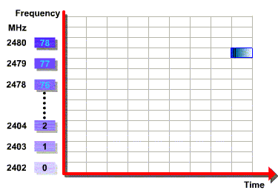

Bluetooth channel is represented by a pseudo random hopping sequence through the entire 79 RF frequencies
Nominal hop rate of 1600 hops per second
Channel Spacing is 1 MHz
Bluetooth

Slide 36
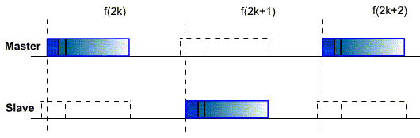
Bluetooth devices use a Time-Division Duplex (TDD) scheme
Channel is divided into consecutive slots (each 625 μs)
One packet can be transmitted per slot
Subsequent slots are alternatively used for transmitting and receiving
  Strict alternation of slots b/t the master and the slaves
  Master can send packets to a slave only in EVEN slots
  Slave can send packets to the master only in the ODD slots
Bluetooth

Slide 37
At the baseband level, Bluetooth uses 3 error correction schemes:
1/3 rate FEC (forward error correction)
  Used in high quality voice pkts
  This scheme sends 3 copies of each bit. Each received triple of bits is mapped into whichever bit is the majority
2/3 rate FEC
  Used in data or voice pkts
  Uses Hamming code: can correct all single errors and detect all double errors in each codeword
ARQ (Automatic Repeat Request)
  Used with data or voice pkts
  Error detection: dest discards pkts in error. Uses a CRC error detecting code
  Positive ack: dest returns a positive ack to error-free pkts
  retransmission after time-out
  Nack and retransmission: dest returns a nack to pkts in error. The source retransmits such pkts.
Bluetooth
Notes:
Mobicom 2000
Aug 6, 2000
Tutorial 3: Bluetooth

Slide 38

Security Measures
    Limited/Restricted Access to authorized users.
    Both Link Level Encryption & Authentication.
    Personal Identification Numbers (PIN) for device access.
    Long encryption keys are used (128 bit keys).
    These keys are not transmitted over wireless. Other parameters are transmitted over wireless which in combination with certain information known to the device, can generate the keys.
    Further encryption can be done at the application layer.
Security values
    Device Address-Public
    Authentication Key(128 bits)-Private
    Encryption Key(8-128 bits)-Private
Bluetooth

Slide 39
Does not address routing, most network functions are pushed into the link layer
Does not support multi-hop multicasting
Does not address how to cope with mobility
The MASTER node is the bottleneck
No. of nodes in piconet is limited
Does not address power-saving methods done at upper layers, above the link-layer
Bluetooth
Notes:
Mobicom 2000
Aug 6, 2000
Tutorial 3: Bluetooth

Slide 40

A new global standard for data and voice
Eliminate Cables
Low Power, Low range, Low Cost network devices
Delivers Automatic synchronicity between devices
Future Improvements
    Master-Slave relationship can be adjusted dynamically for optimal resource allocation and utilization
    Adaptive, closed loop transmit power control can be implemented to further reduce unnecessary power usage
Bluetooth

Slide 41

[1] Bluetooth Consortium :
    http://www.bluetooth.com
    http://www.ericsson.com/bluetooth/
[2] Bluetooth Tutorial :
    http://www.ee.iitb.ernet.in/uma/~aman/bluetooth
    http://www.palowireless.com
[3] G.F.Pedersen, P.Eggers, “Initial Investigation of the Bluetooth Link”, VTC, pp 64 – 70
[4] J.C.Haartsen, et al, “Bluetooth – A New Low-Power Radio Internface Providing Short-Range Connectivity”, IEEE Proc. , Vol 88, No.10, Oct 2000
[5] Min-Chul Ju, et al. , “Channel Estimation and DC-Offset Compensation Schemes for Frequency Hopped Bluetooth Networks”, IEEE Communications Letters, Vol 5, No.1, Jan 2001
Bluetooth

